Slide 1

MERN Ballroom Dance Studio Management System

Slide 2
class Project3 extends Project2 { constructor(“View & Schedule Events”, “Track & Manage Attendance”, “Kicks chat system” ) { super(“it’s all there”); this.add = [“Invoice & Payment System”, “Live Chat”] this.refactor = “Use MongoDB & React, theme to Ballroom Dance Studio” this.versatile = “Practical, user-friendly software that can be used for countless purposes. } };

Slide 3
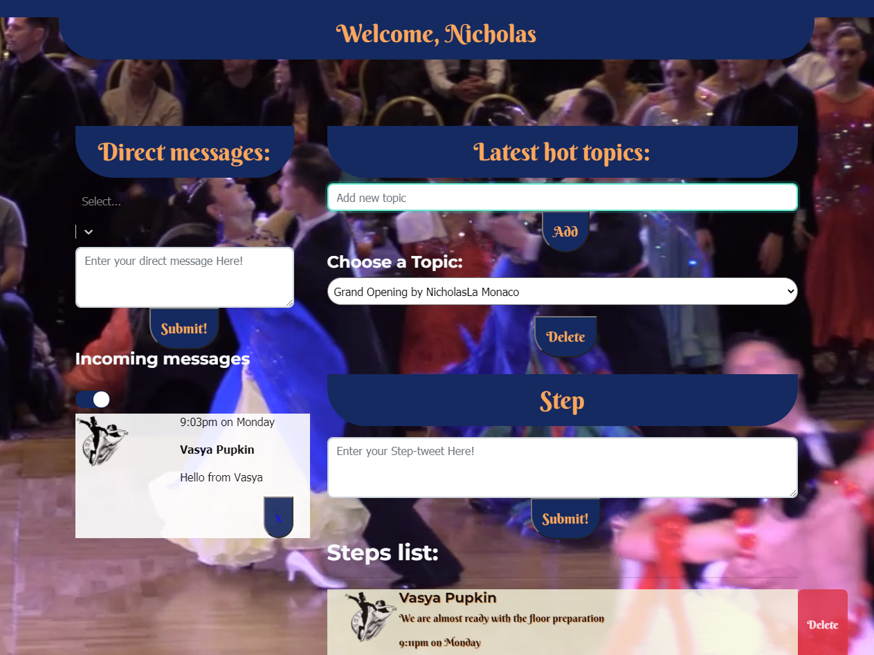
MONGODB – DIRECT MESSAGING
Database model for “Steps” includes the ability to send a direct message to another user, as well as post publicly.
Users can tell when their message has been seen or not. Don’t leave us on read!

Slide 4
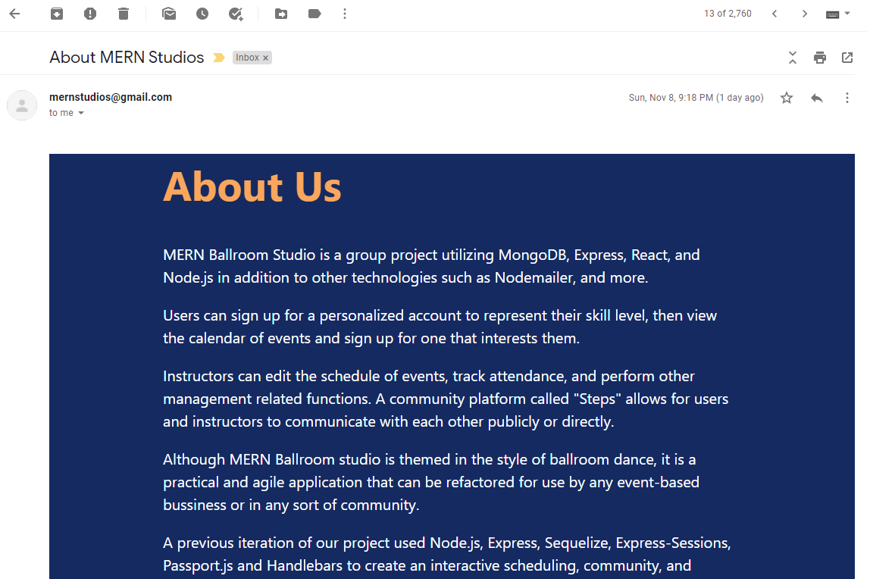
NODEMAILER – SERVER-SIDE EMAIL
Server-Side email from Node.js, can access premade HTML templates from a key:value pair on our server, and send them to recipients.
In conjunction with other existing API routes and database models, we can send event reminder to a single user, to everyone registered to a particular class, or a marketing e-mail to the entire community.

Slide 5
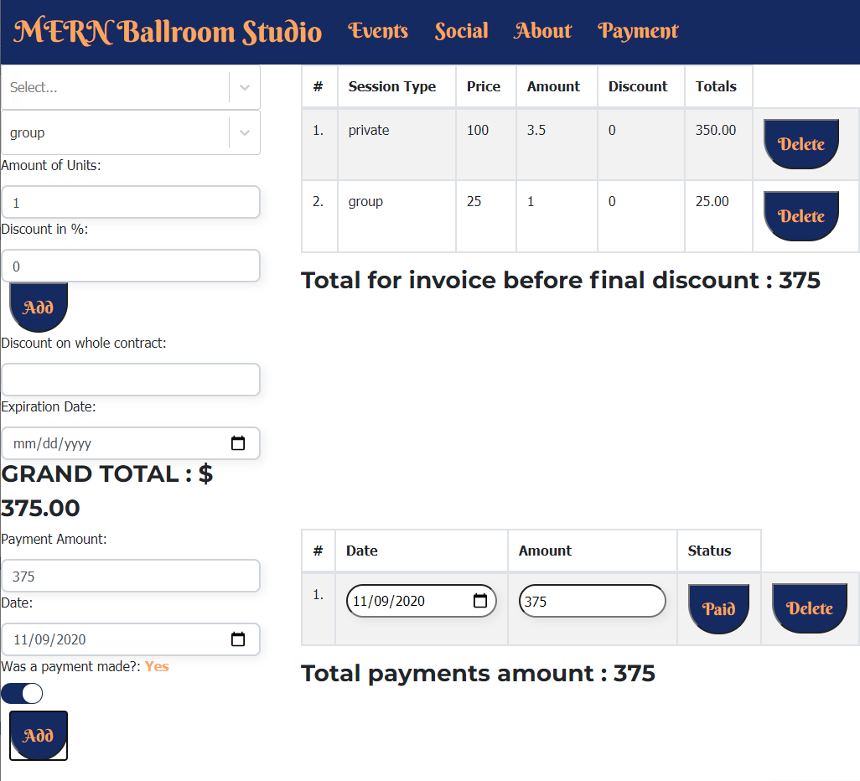
REACT - INVOICE SYSTEM
Generate invoices for individuals or groups with customized pricing.
Apply discounts to items to reward new or longtime customers.
Mark invoices as paid or not paid, as well as delete them.

Slide 6
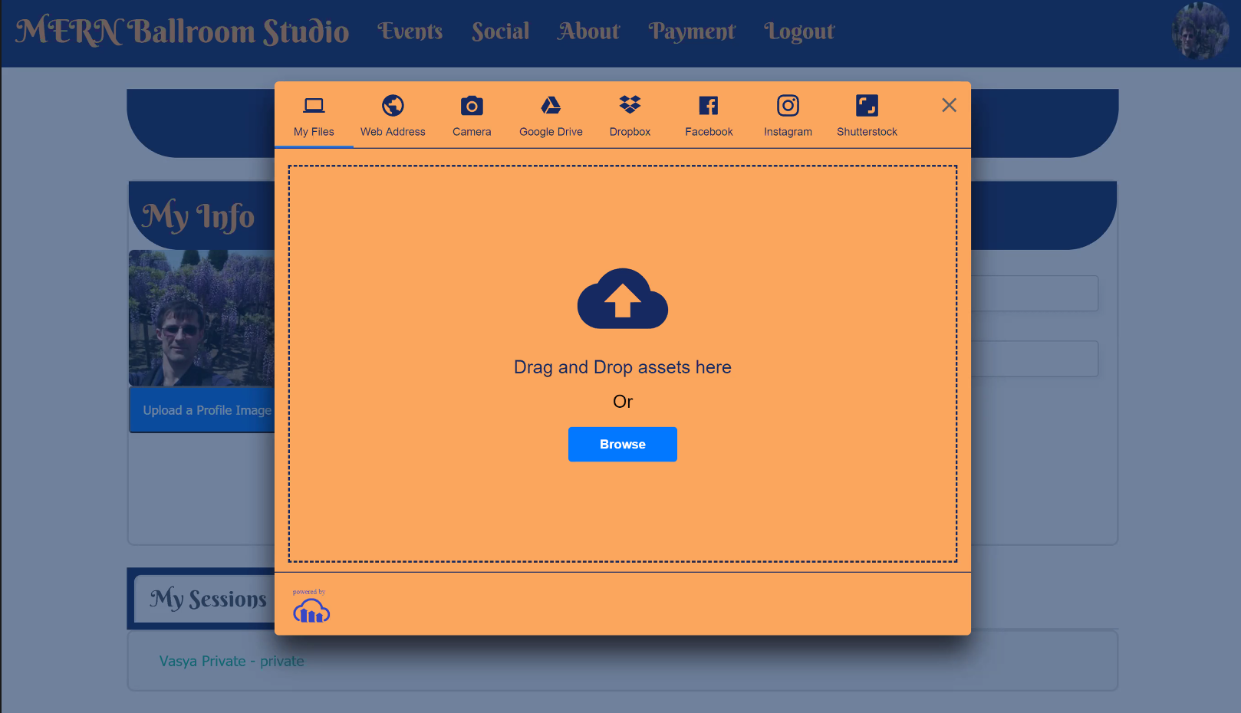
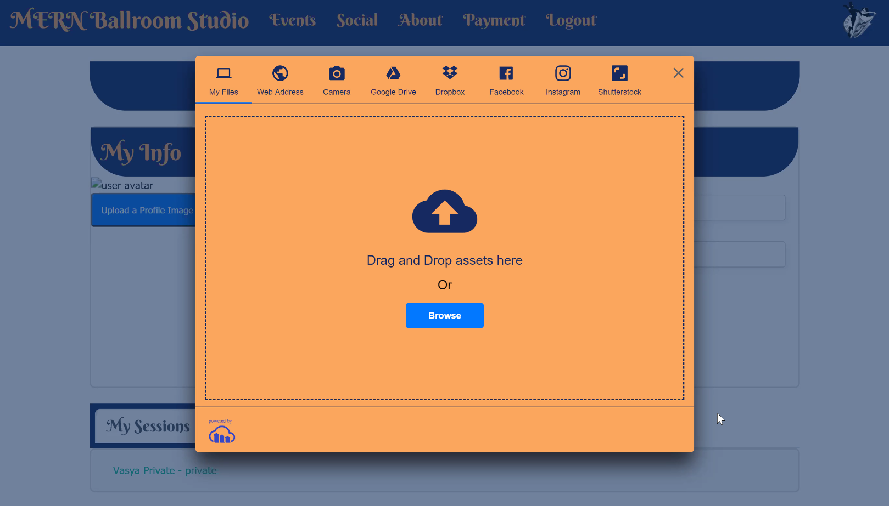
REACT-CLOUDINARY
Personalized user profiles can be updated to include profile photos, using secure cloud upload.

Slide 7
FUTURE DEVELOPMENT
CONNECT INVOICES TO STUDENT MODEL
PAYROLL SYSTEM
STRIPE
REACT-BIG-CALENDAR

